Slide 1
Extra Material for P1W3D3

Slide 2
P1 W3 D3 AM
GAUSSIAN MIXTURE MODEL

Slide 3
KMeans - Advantages
Guaranteed to converge in a finite number of steps (usually quite small iterations).
One of the fastest clustering algorithm.
Easy to understand.

Slide 4
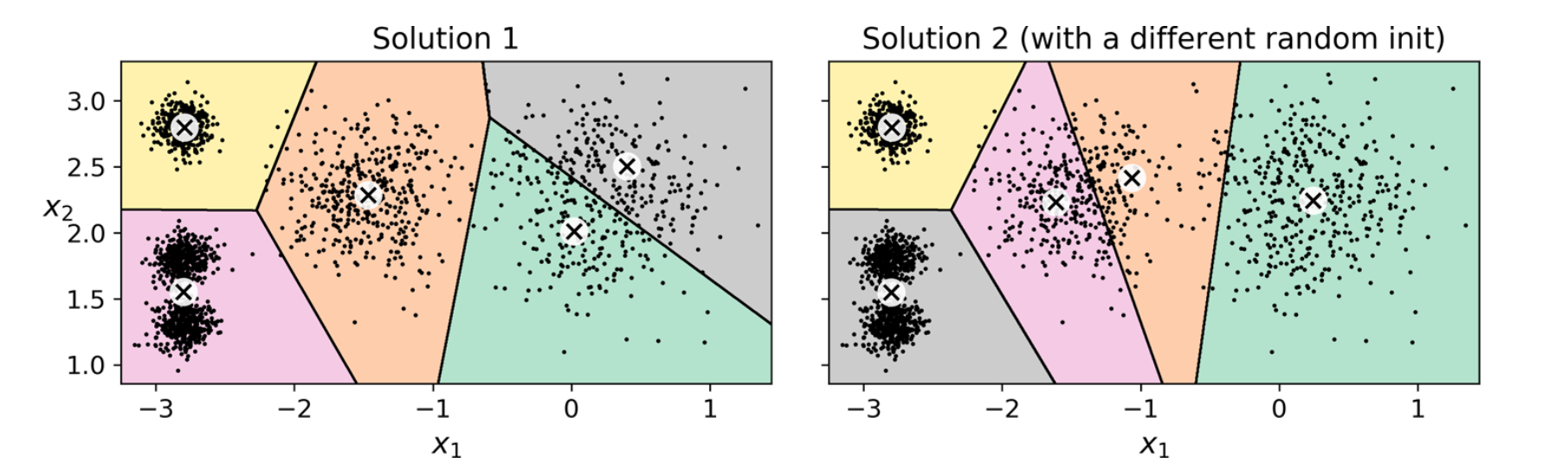
KMeans - Disadvantages (1)
Depends on the centroid initialization.

Slide 5
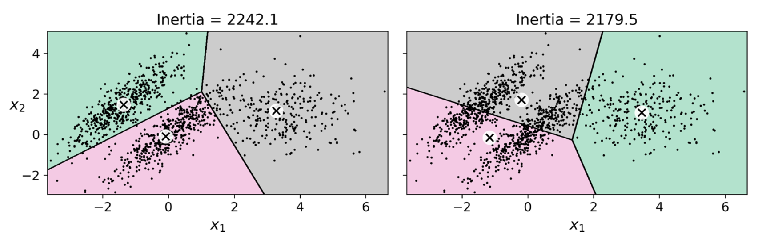
KMeans - Disadvantages (2)
KMeans does not behave very well when the clusters have varying sizes, different densities, or non spherical shapes.

Slide 6
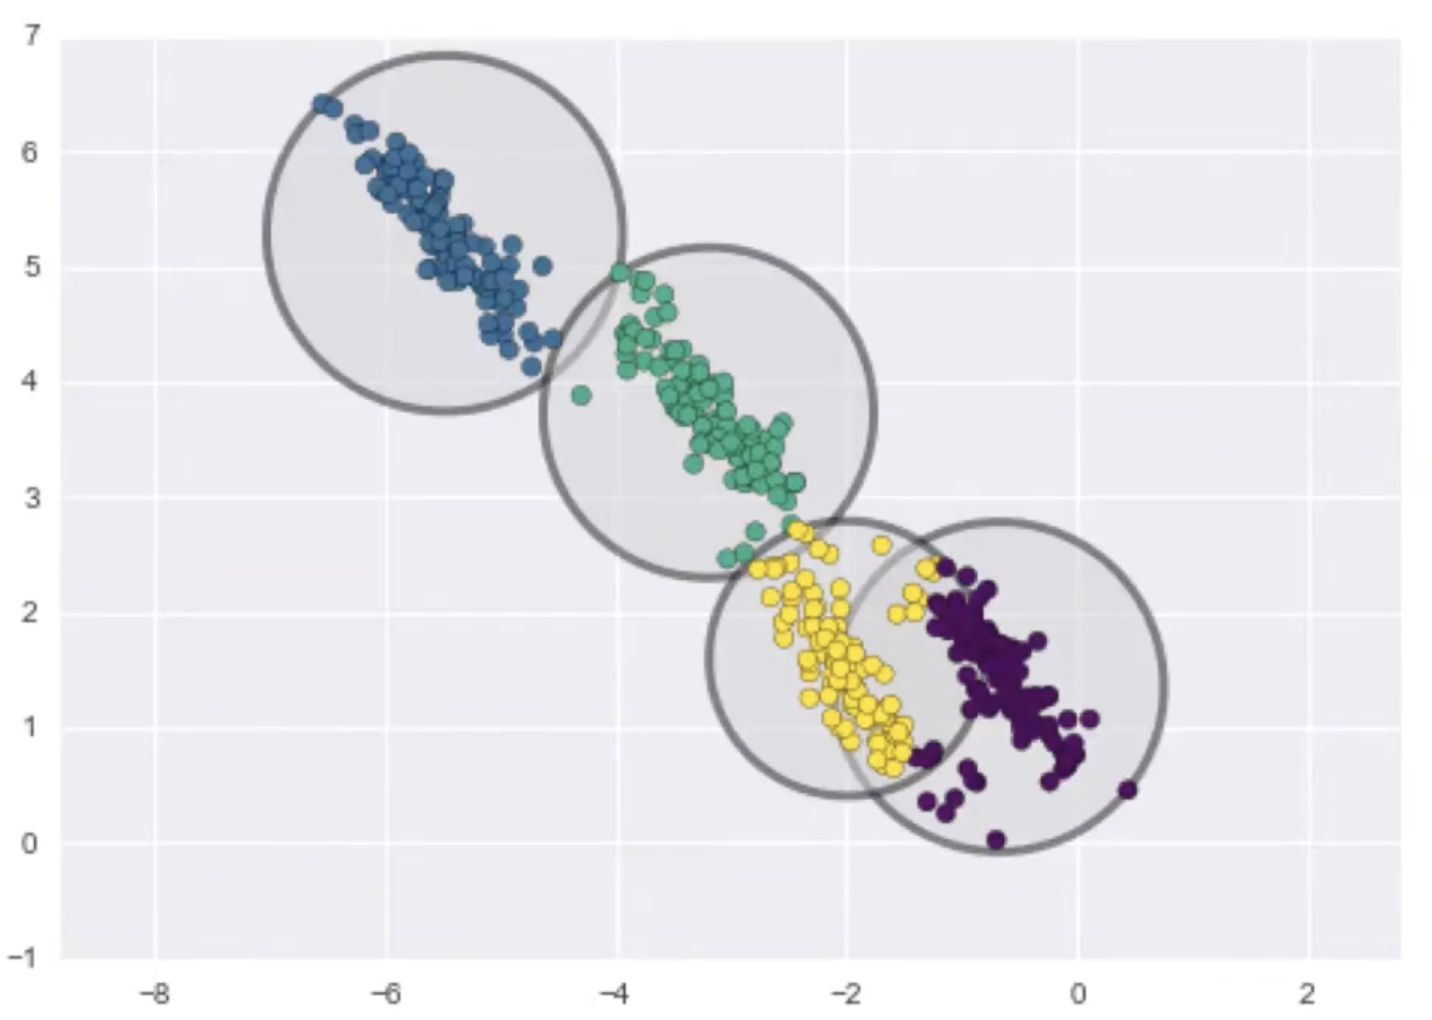
KMeans - Disadvantages (3)
KMeans is a hard-clustering technique.

Slide 7
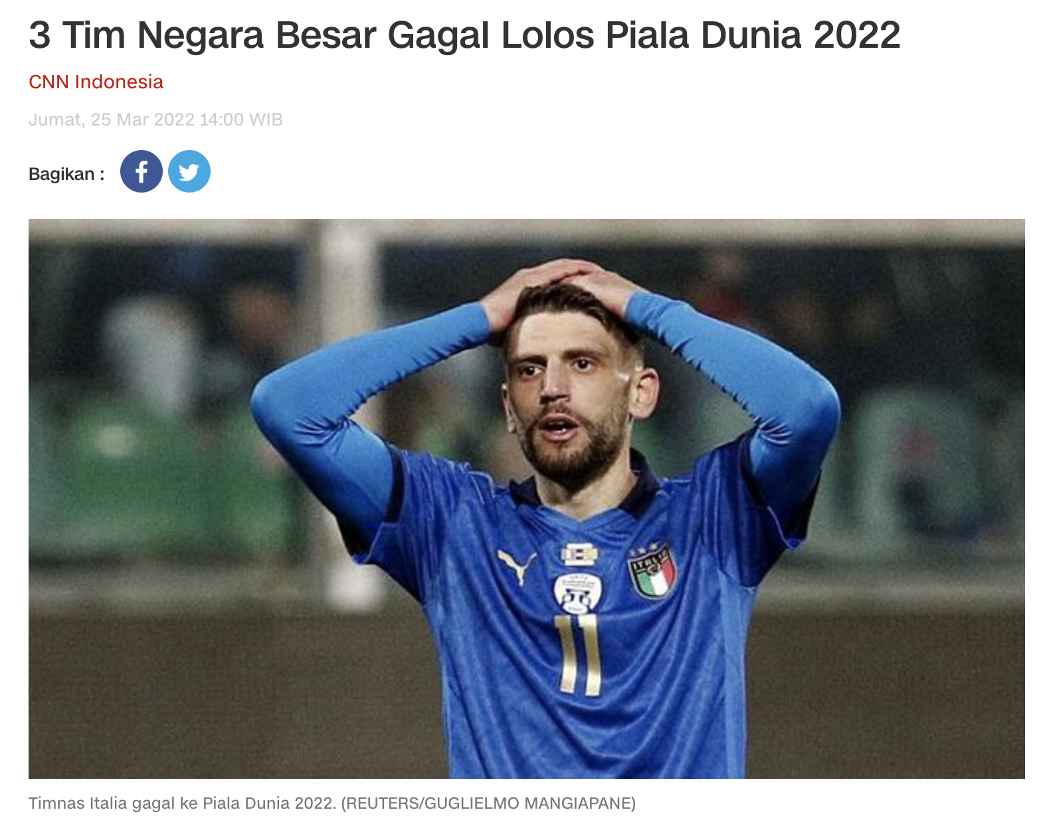
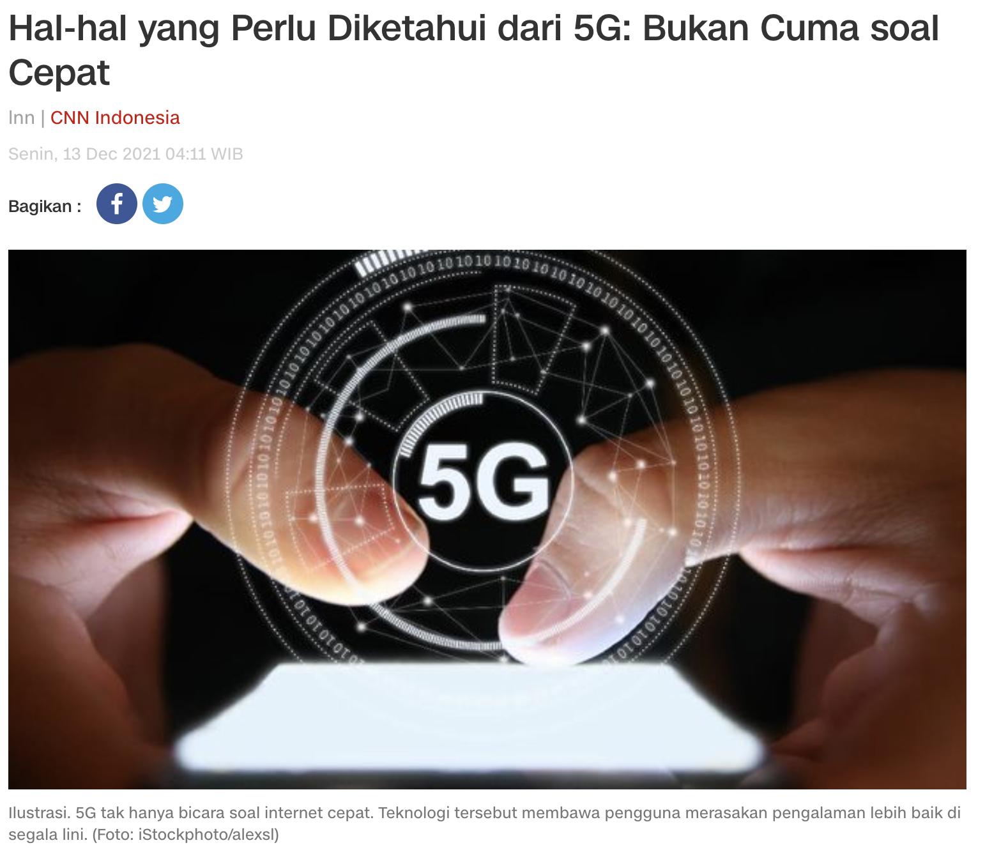
Problem : News Clustering (1)
Cluster 1 : news related to Sport.
Cluster 2 : news related to Technology.

Slide 8
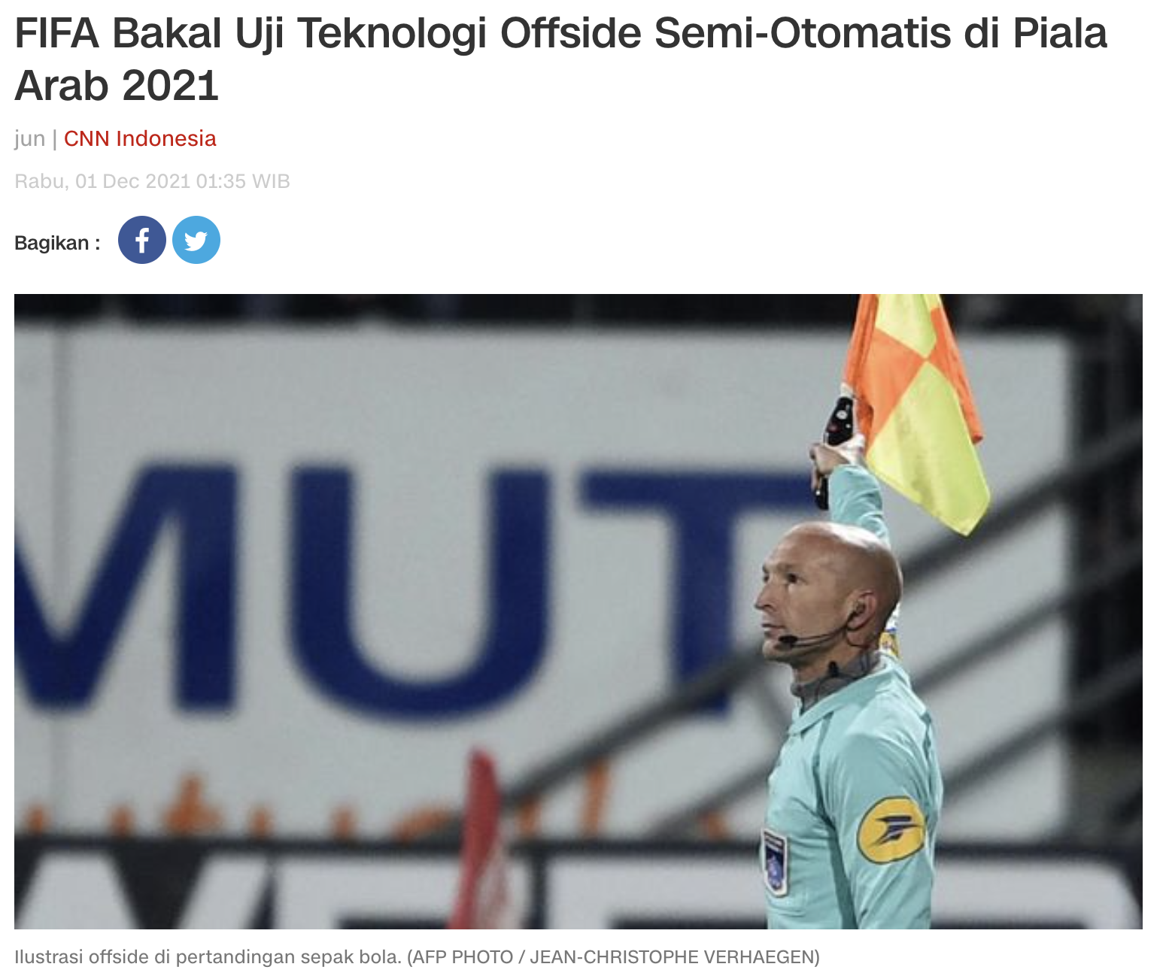
Problem : News Clustering (2)
Which cluster for this news ?

Slide 9
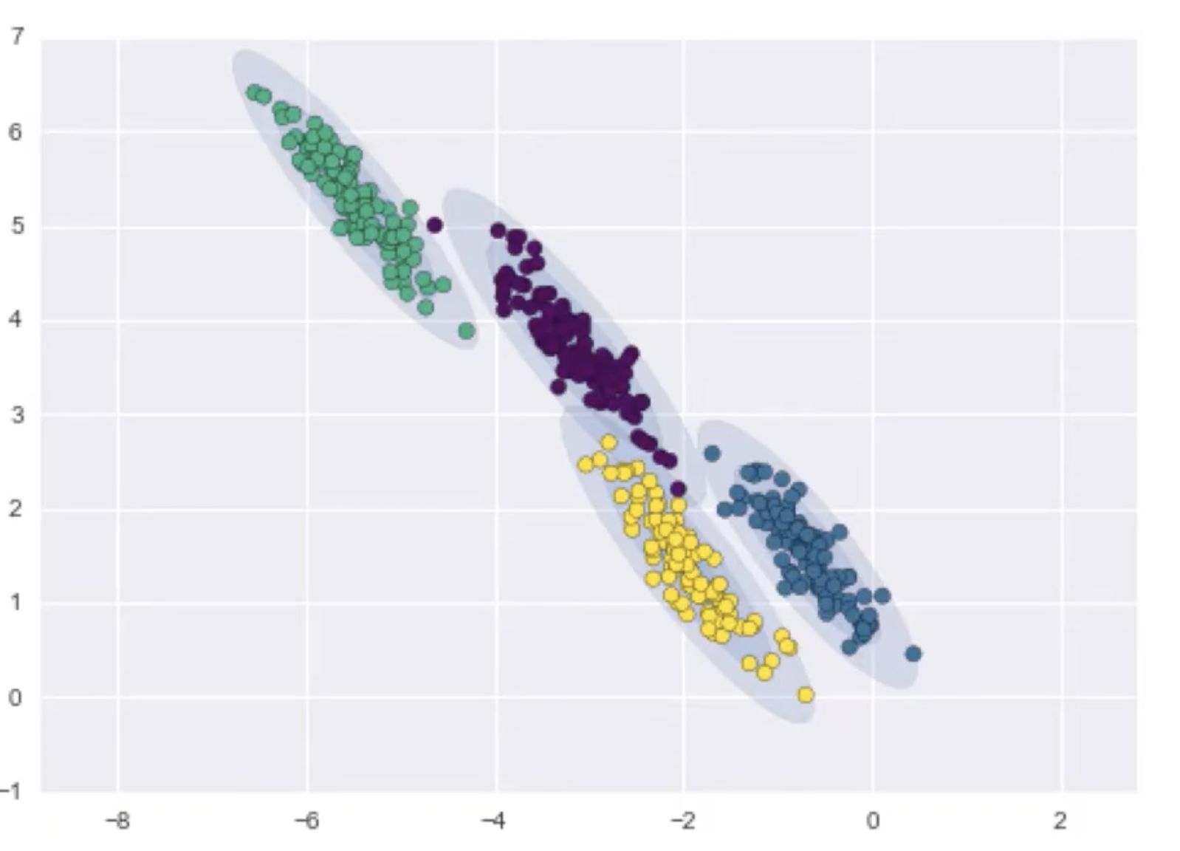
KMeans vs GMM
KMeans :
Good for spherical-shape
Hard clustering
GMM :
Good for non spherical-shape
Soft clustering

Slide 10
Gaussian Mixture Model (1)
Using probabilistic approaches.
Based on Expectation-Maximisation algorithm.
GMM is a model that assumes data generated from a mixture of K Gaussian (bell shape) components.

Slide 11
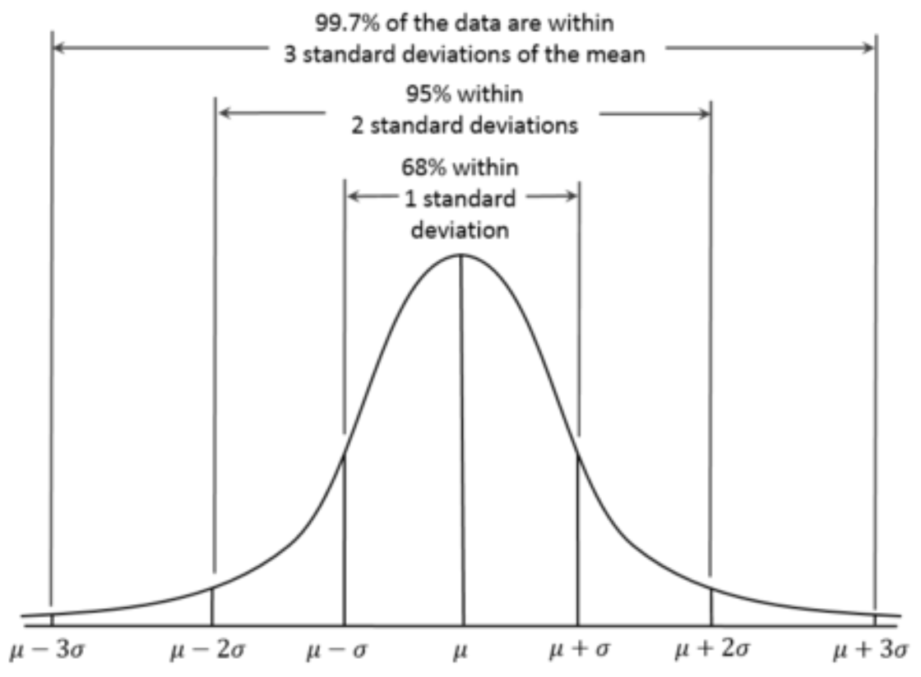
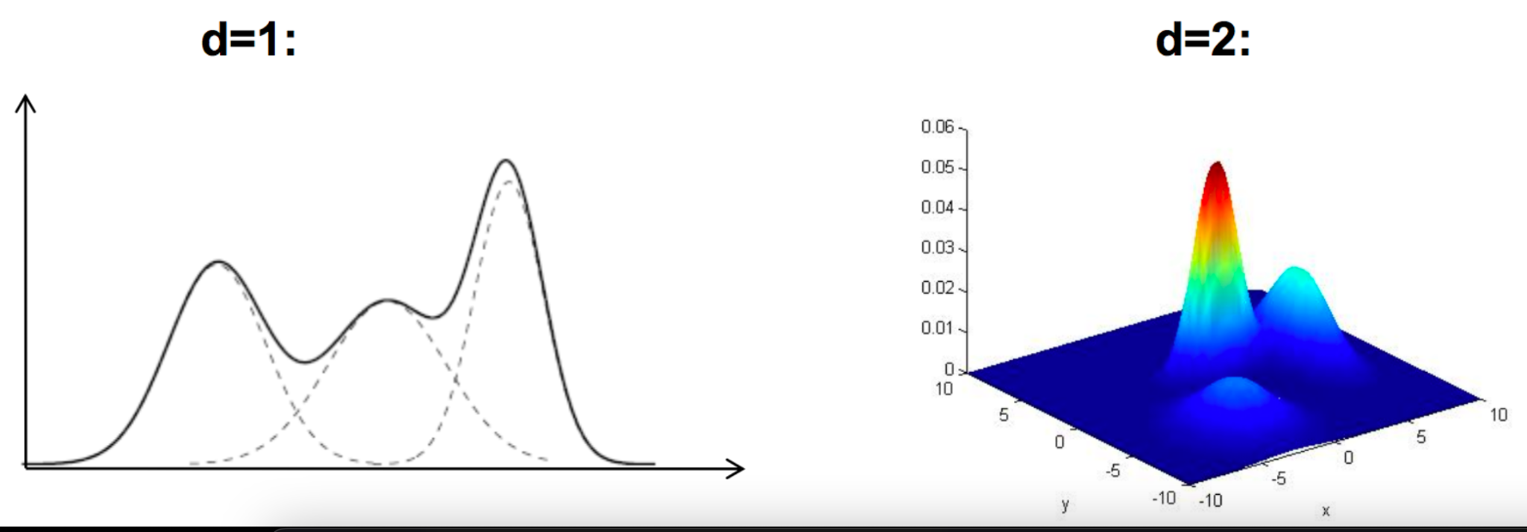
Gaussian Mixture Model (2)

Slide 12
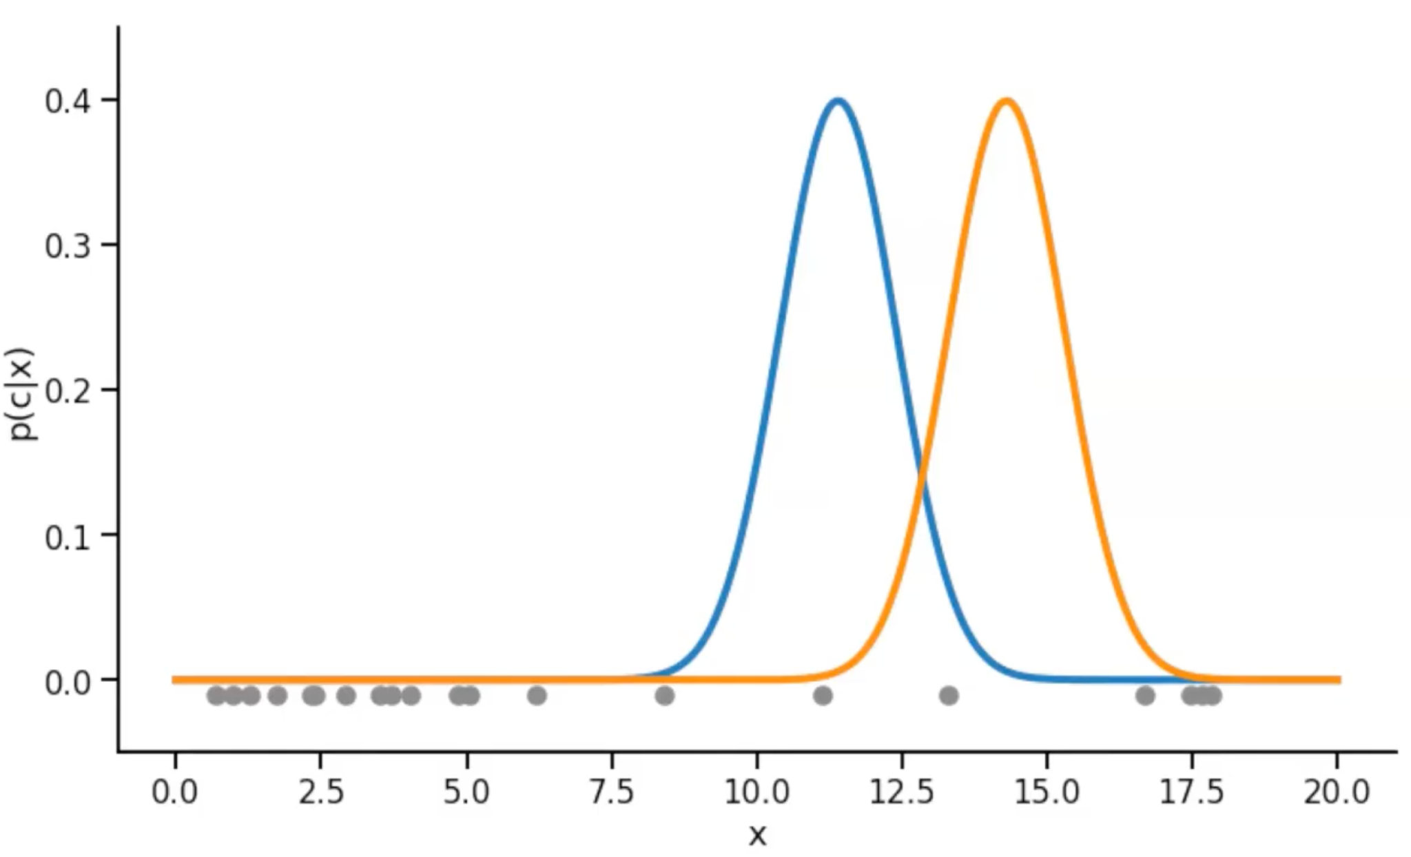
Gaussian Mixture Model - Illustration (Iteration 1)

Slide 13
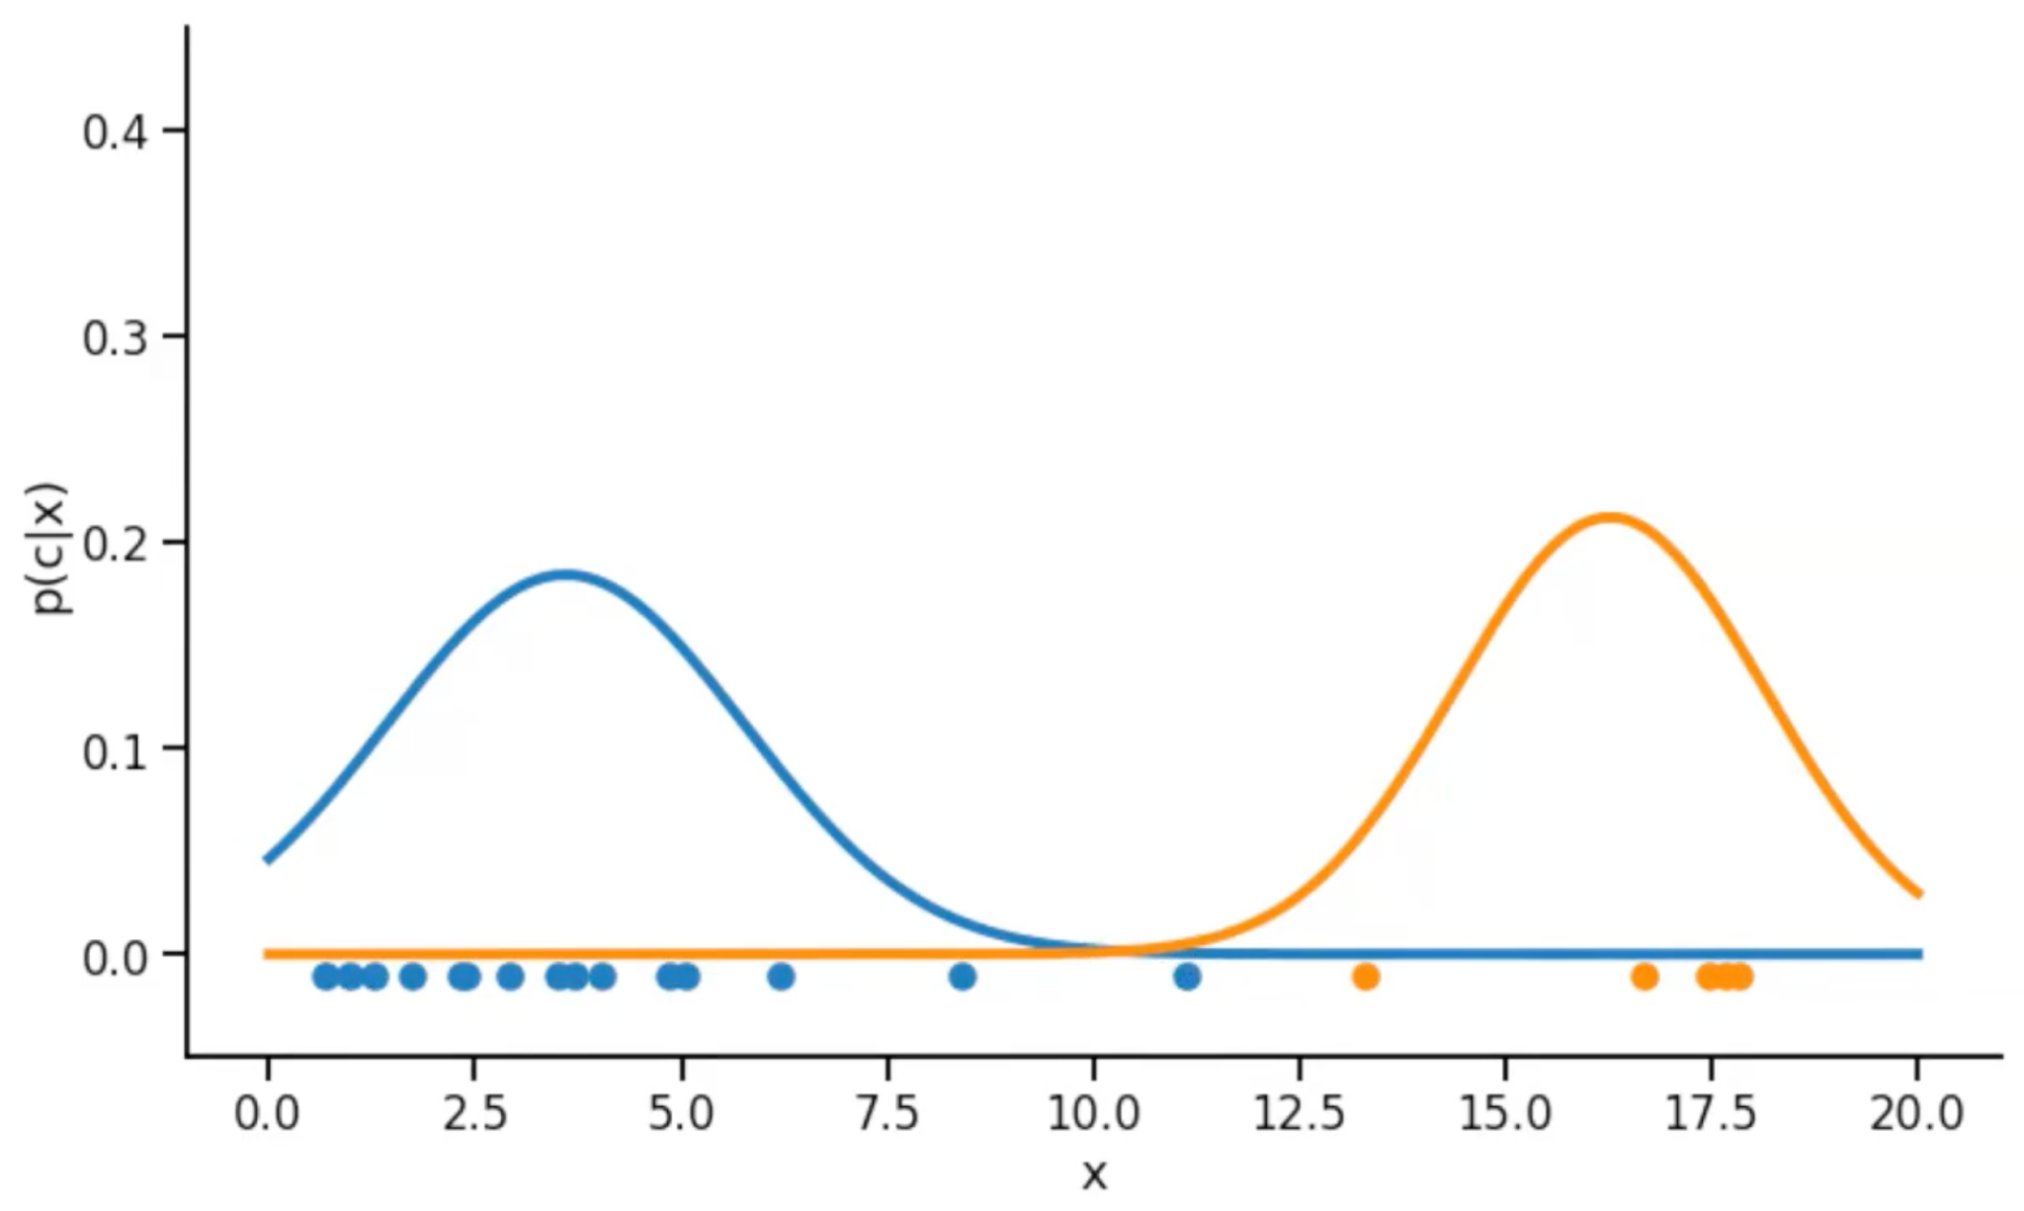
Gaussian Mixture Model - Illustration (Iteration 2)

Slide 14
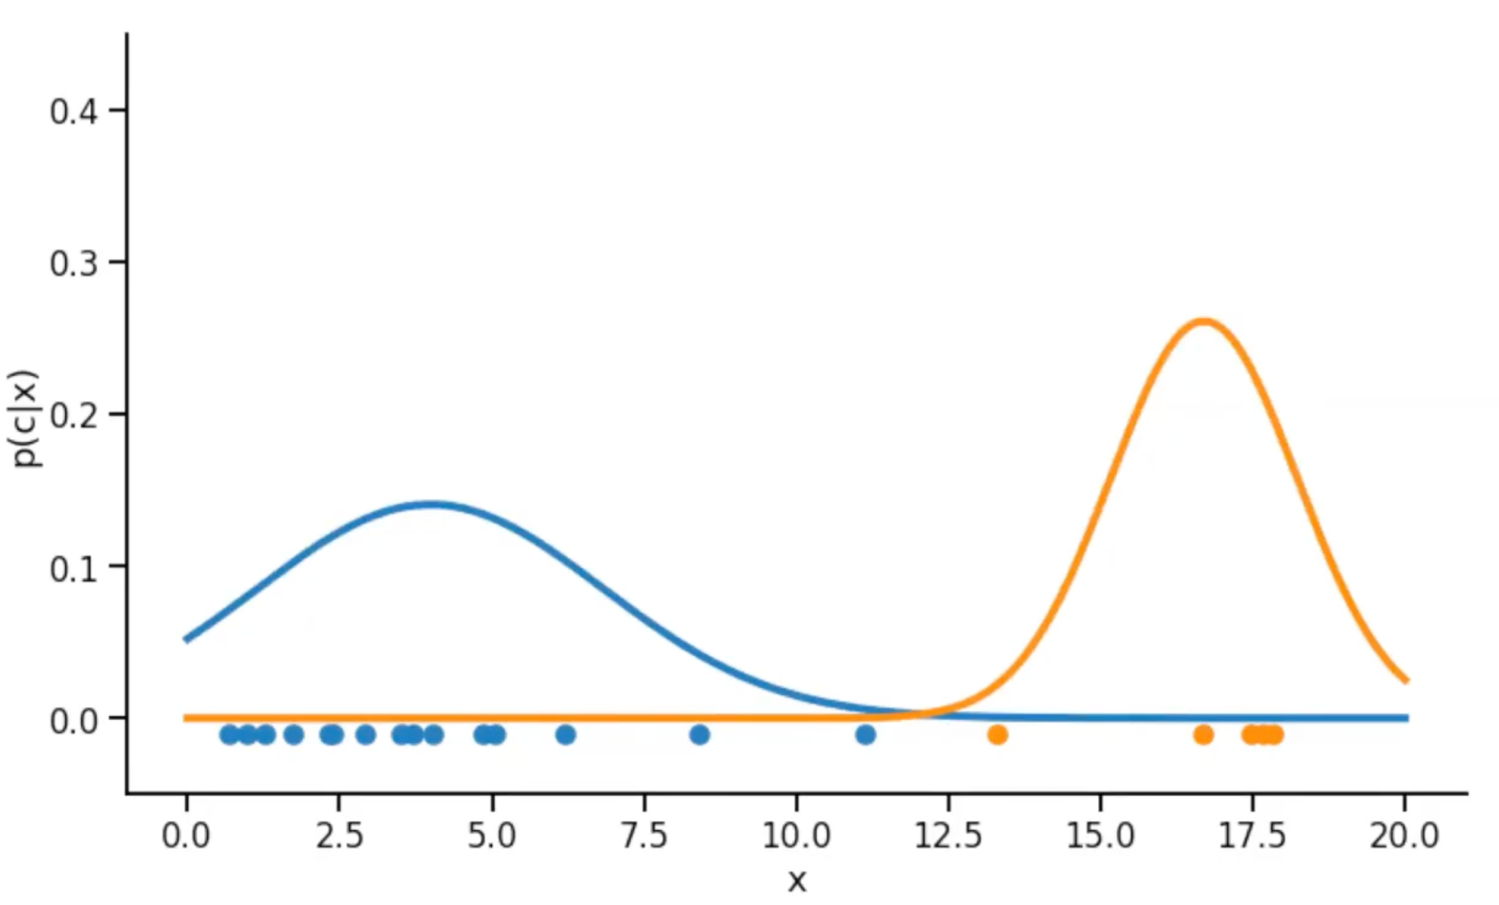
Gaussian Mixture Model - Illustration (Iteration 3)

Slide 15
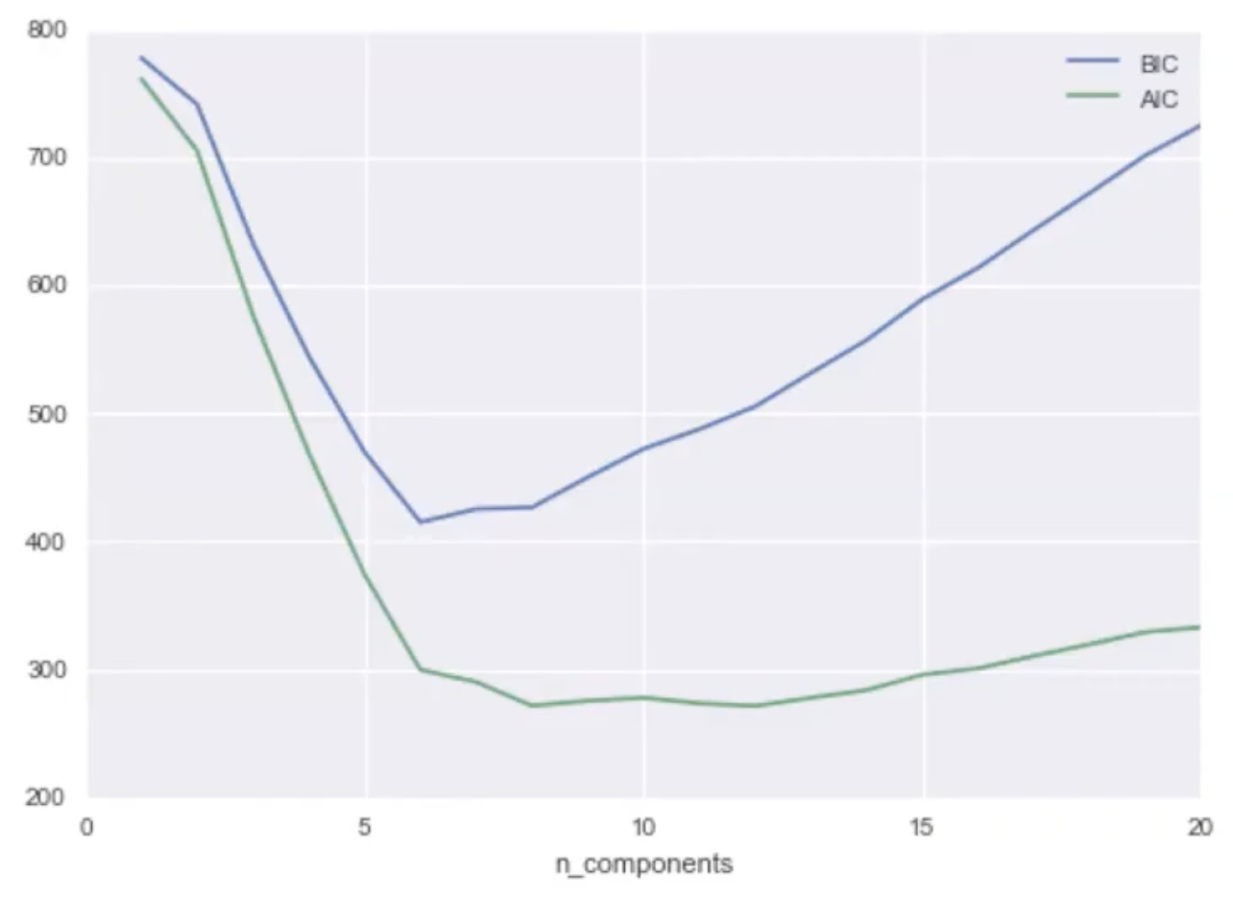
BIC & AIC

Slide 16
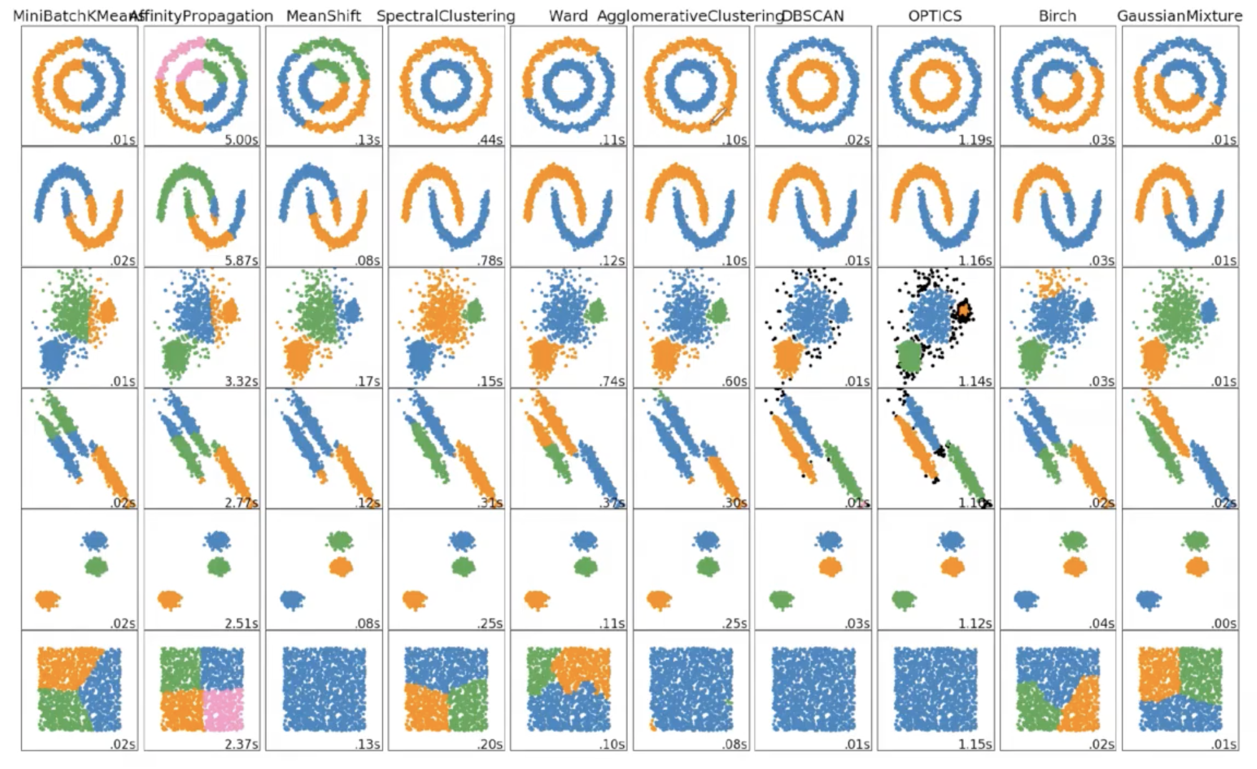
Algorithm Comparison

Slide 17
P1 W3 D3 PM

Slide 18

Illustration (Outlier)

Slide 19
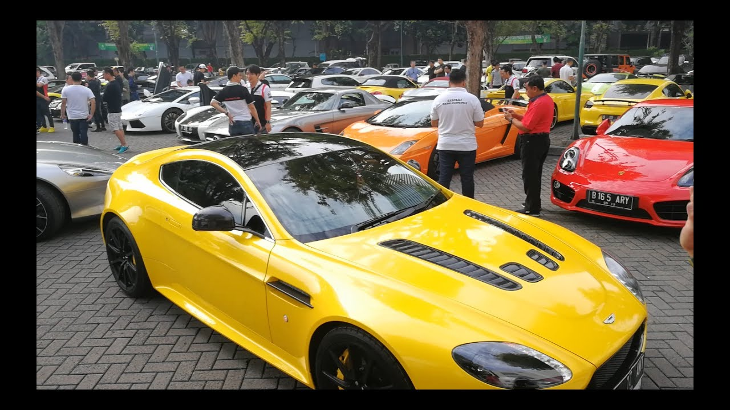
Illustration (Novelty)

Slide 20
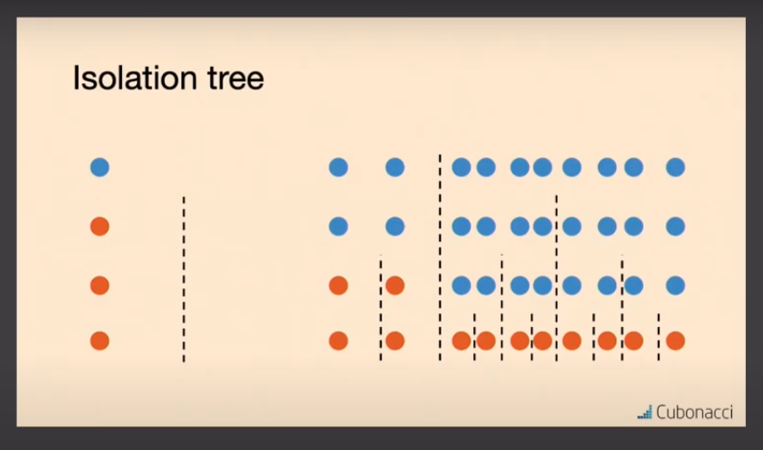
Isolation Forest (1)

Slide 21
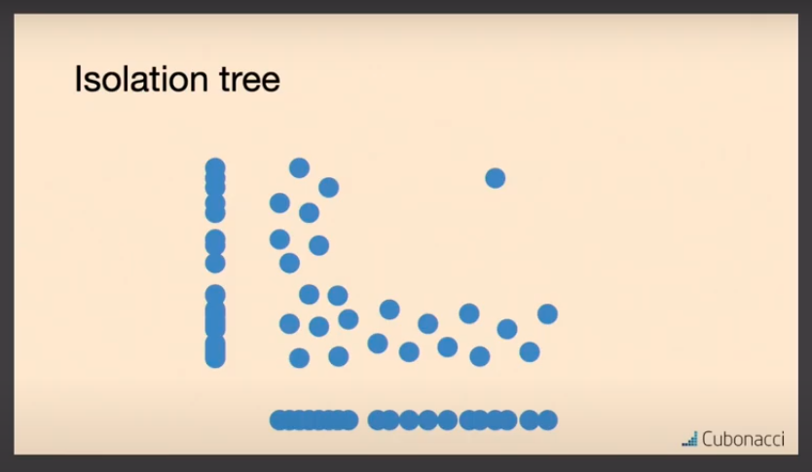
Isolation Forest (2)

Slide 22
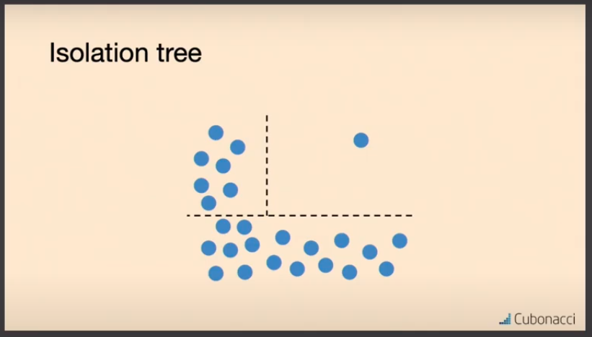
Isolation Forest (3)

Slide 23
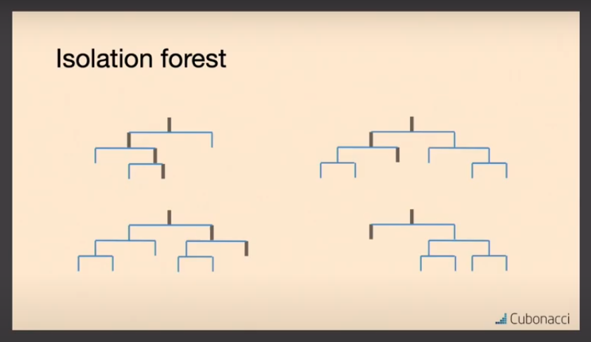
Isolation Forest (4)

